Slide 1

Hate Crime Trends in the United States
Trevor Laskey
William Eveloff
Amber Lukaesko
Jongwoo Lee

Slide 2

What is Hate Crime?
Hate Crime:
“A hate crime is a traditional offense like murder, arson, or vandalism with an added element of bias.
For the purposes of collecting statistics, the FBI has defined a hate crime as a “criminal offense against a person or property motivated in whole or in part by an offender’s bias against a race, religion, disability, sexual orientation, ethnicity, gender, or gender identity.”
- Federal Bureau of Investigation

Slide 3

Background and Methodology
Hate crimes have been tracked since President H.W. Bush signed the Hate Crimes Statistics Act of 1990; expanded in 2009.
The FBI Uniform Crime Reporting Program collects voluntary reports from local jurisdictions and provides data access through its Crime Data Explorer (CDE), which includes hate crimes.

Slide 4

Exploratory
Time Frame: 1991-2017
194,194 Incidents
50 States + Guam
308 types of offenses*
117 locations of offense*
125 types of biases*
50 victim types*
*Many entries include various terminology for similar info as well as different combinations of info types into single entries.

Slide 5
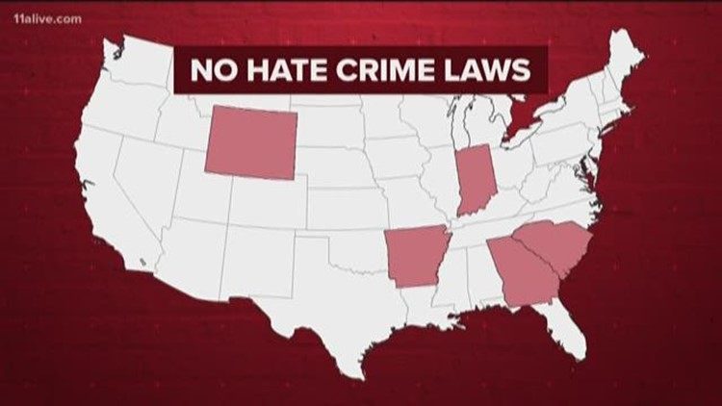
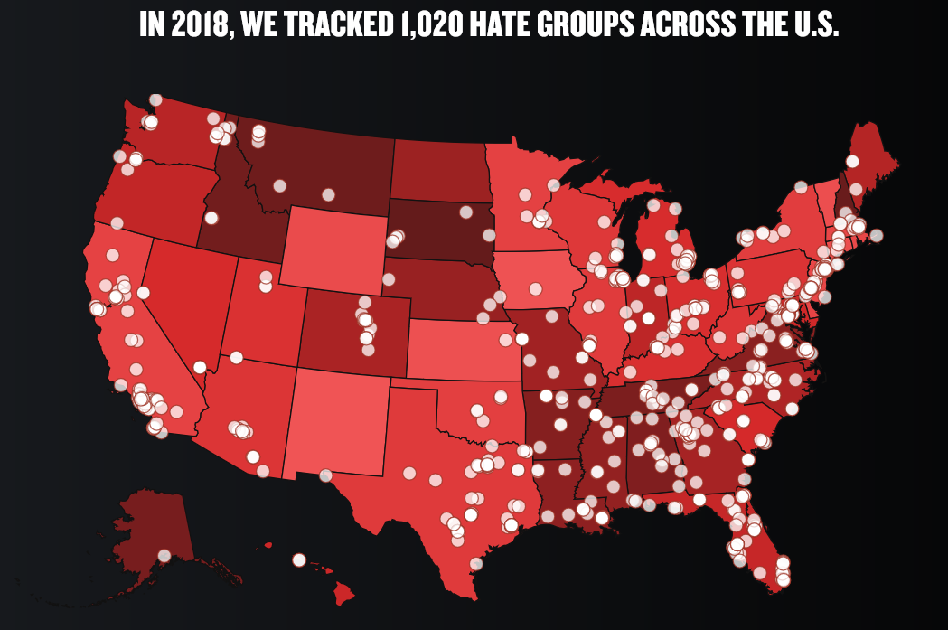
Limitations of FBI CDE Data
The FBI CDE Hate Crimes data set is robust, but most data is categorical, and some inconsistency of entries. Also, the data’s representation of the population is limited and inconsistent.
The Bureau of Justice Statistics hate crime survey conducted in 2012 reported 293,800 hate crimes; 50x’s FBI reported data that year. Why?
Since FBI tracking in 1996, over 80% of jurisdictions reported 0 hate crimes; 88.4% reported 0 hate crimes in 2015
Hate crime reporting to FBI voluntary, and many state, city, local police agencies do not collect nor disclose the data
Police officers may not acknowledge a crime as hate crime, possibly due to no local hate crime laws, bias, etc..
Not all hate crimes are reported to police possibly due to fear
States without local hate crime laws have limited hate crimes reporting (AK, GA, SC, WY, IN)
CA, NJ, and NY report a lot of hate crimes(>36% of total), while most deep South states don’t report hate crimes
In contrast to reporting data, the Southern Poverty Law Center reports hate group concentration in South & East; pockets in West

Slide 6
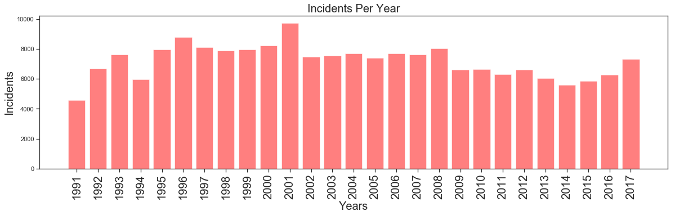
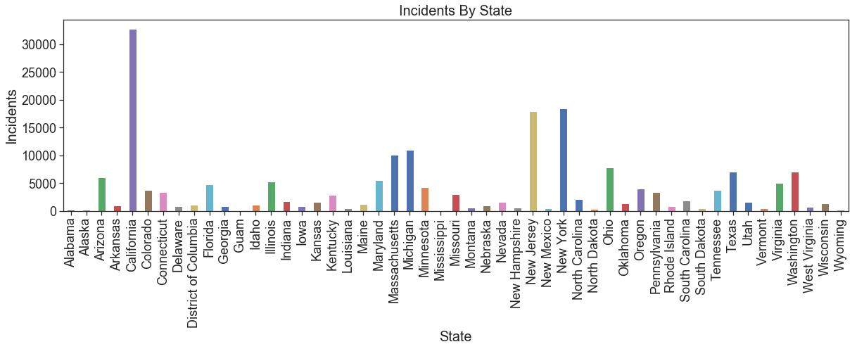
Overview
Based on Time
Based on Geography
Notes:
Comments: 2001 spiked due to 9/11; California, New Jersey, New York has highest incident count

Slide 7
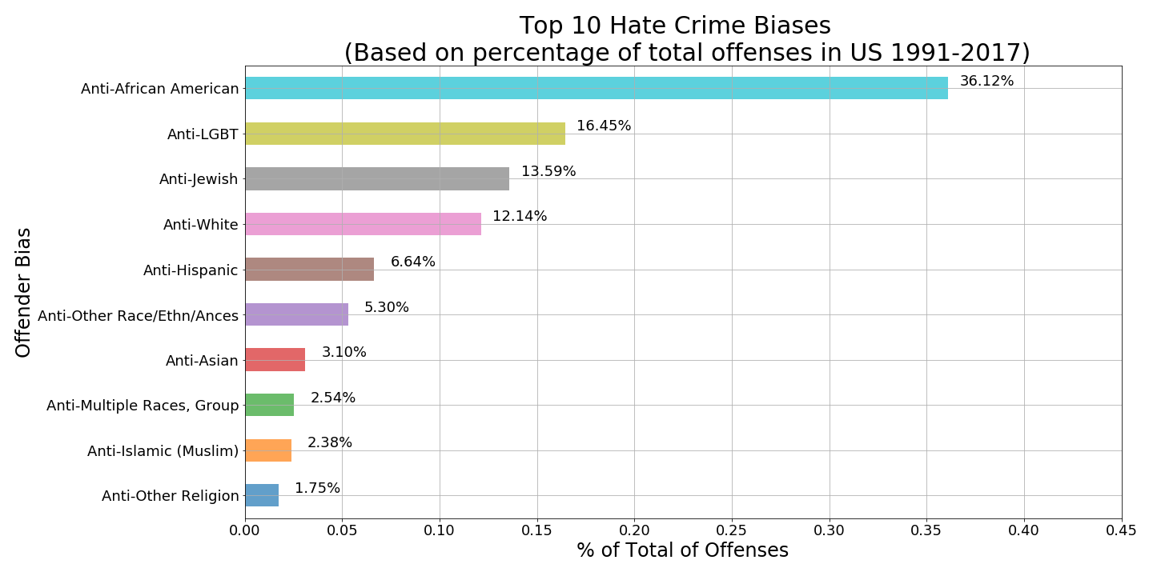
What are the top Hate Crime Biases against victims…
in the US?
Focused on biases (BIAS_DESC), which required data cleaning
Refined top 10 with groupby, count & sort_values functions.
Calculated percentage and used sort_values for bar chart
Bar text thru for loop:
for p in axp.patches:
width = p.get_width()
plt.text(.02+p.get_width(),p.get_y()+0.8*p.get_height(),
'{:.2%}'.format(width),
ha='center', va='center')
plt.rc('font', size=18)
Some bias description data abbreviated in analysis for visualization:
Anti-LGBT = Anti-Lesbian, Gay, Bisexual, or Transgender (Mixed Group)
Anti-African American = Anti-African American, Anti-Black
Anti-Hispanic = Anti-Hispanic or Latino
Anti-Other Race/Ethn/Ances = Anti-Other Race/Ethnicity/Ancestry

Slide 8
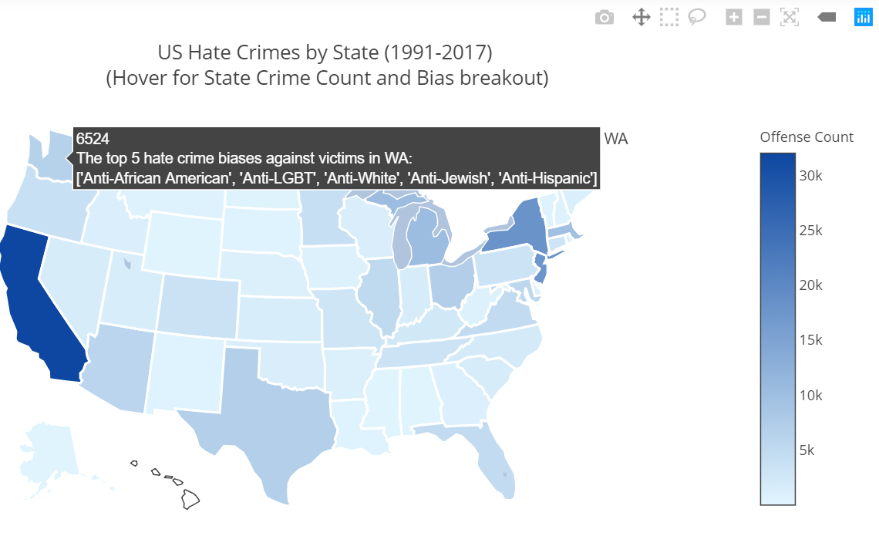
What are the top Hate Crime Biases against victims…
By State?
Determined top 5 hate crime bias’ for each state as dataframe.
Merged top 5 dataframe with a offence count by state.
Utilized Plotly US Choropleth heat map for total offense count and hover capabilities for top 5 per state.
Plotly coding utilizes a data object (data parameters) and a layout object (map parameters)
Some bias description data abbreviated in analysis for visualization:
Anti-LGBT = Anti-Lesbian, Gay, Bisexual, or Transgender (Mixed Group)
Anti-African American = Anti-African American, Anti-Black
Anti-Hispanic = Anti-Hispanic or Latino
Anti-Other Race/Ethn/Ances = Anti-Other Race/Ethnicity/Ancestry

Slide 9
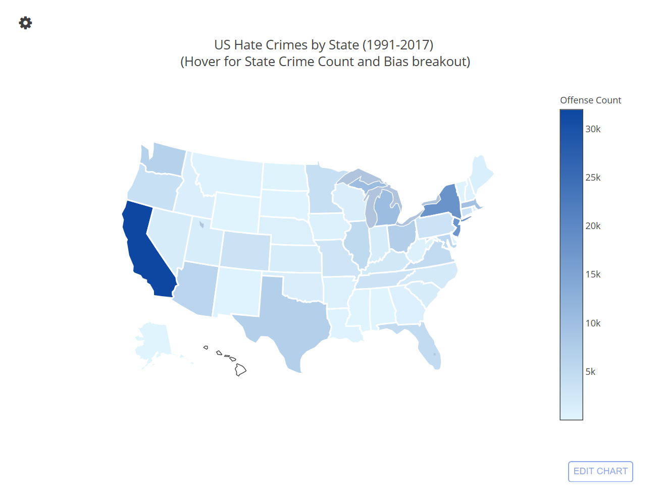
What are the top Hate Crime Biases against victims…
By State?
Determined top 5 hate crime bias’ for each state as dataframe.
Merged top 5 dataframe with a offence count by state.
Utilized Plotly US Choropleth heat map for total offense count and hover capabilities for top 5 per state.
Plotly coding utilizes a data object (data parameters) and a layout object (map parameters)

Slide 10
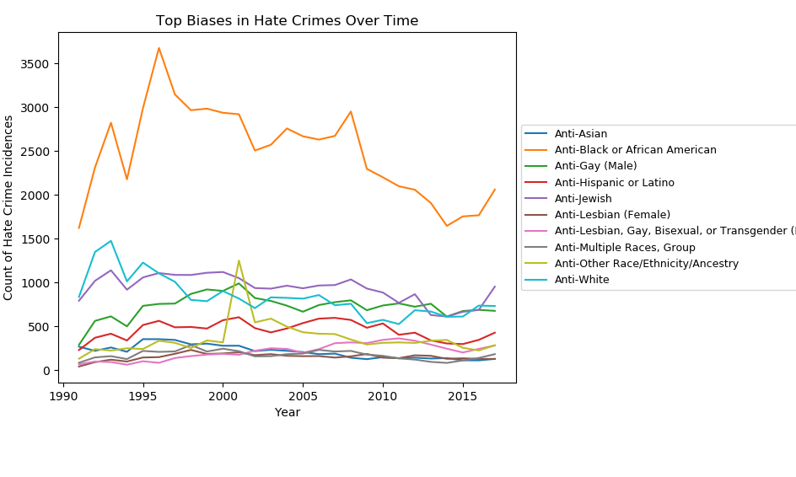
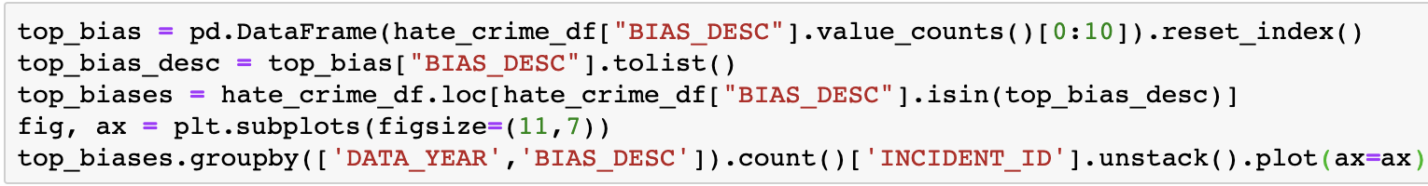
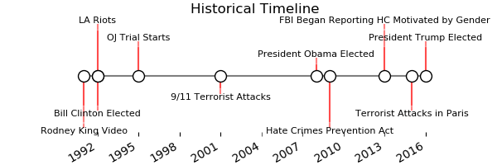
How Do Hate Crime Biases Change Over Time?

Slide 11
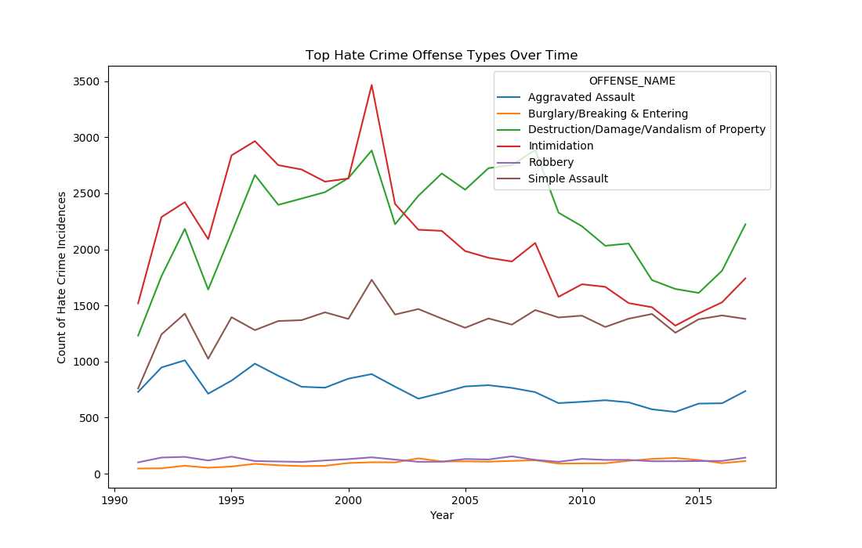
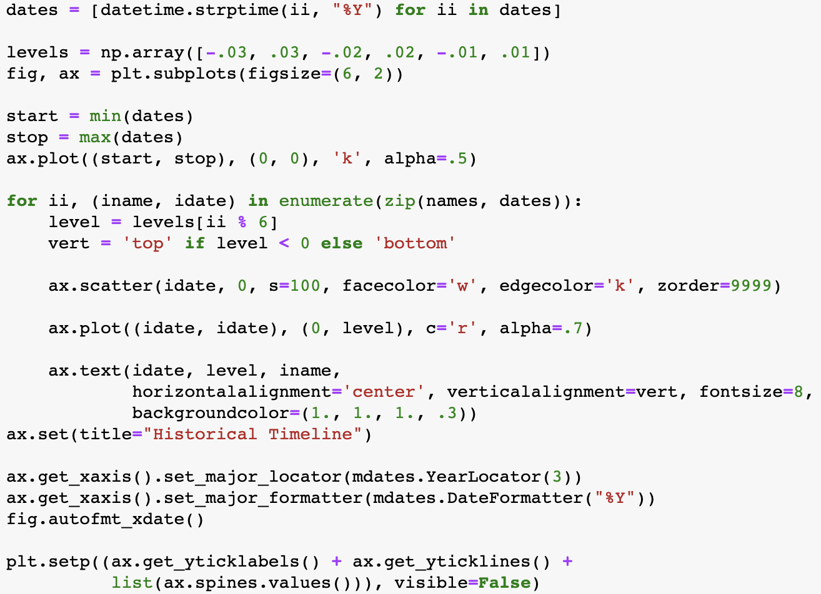
How Do Hate Crime Offenses Change Over Time?

Slide 12
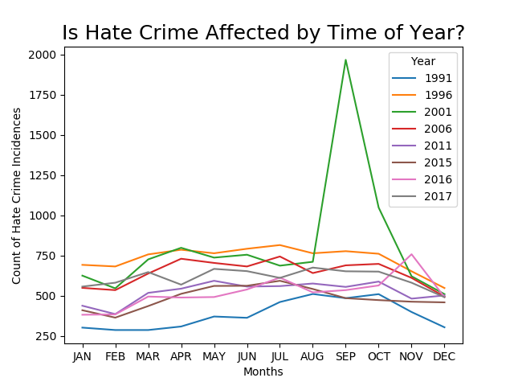

Slide 13
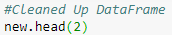
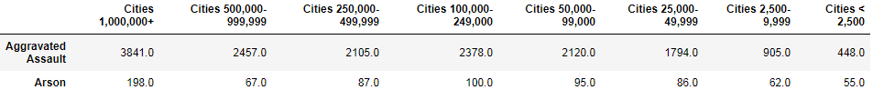
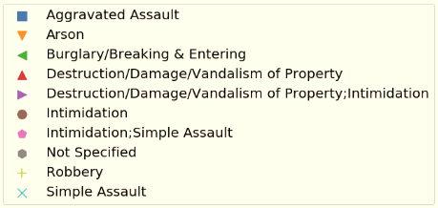
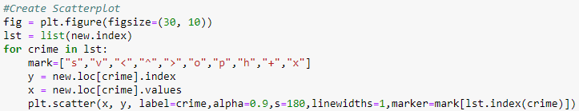
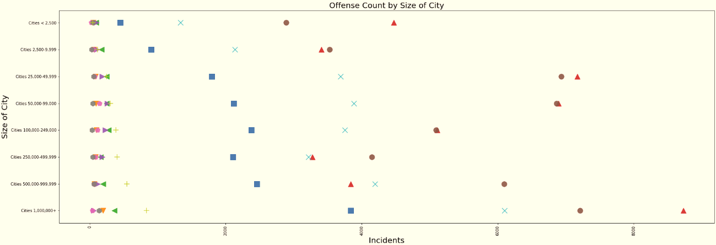
Trends of Hate Crime Offense by Size of City
Notes:
In this visualization, I compared the relationship between hate crime offense type and size of city. First, I narrowed down the hate crime offense to the top ten most occurred offenses, which can be seen in the legend. Then I grouped the offenses by size of city and created a scatterplot that shows how many incidents each hate crime offense type had in each size of city.
I first noticed that in the smallest and largest cities, destruction/damage/vandalism of property was the highest occurring type of hate crime. However, when it came to any city between 2,500-250,000 people the incidents of intimidation and property damage were very close, almost equal. In cities from 250,000 – 999,999 people, there were more intimidation incidents than property damage incidents. With aggravated assault and simple assault, we saw an overall trend of the larger the city’s population became, the more assaults.
Only used top 90% of offense types and city types (MSA/Non-MSA not included)
Most incidents in majority of city sizes were Destruction/Damage/Vandalism of Property and Intimidation…
Not much insight besides more incidents for larger cities...

Slide 14
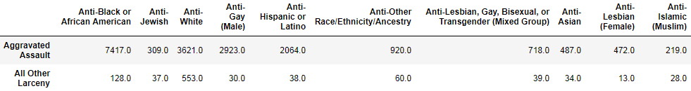
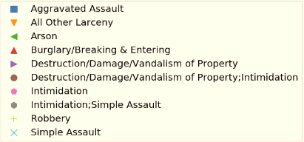
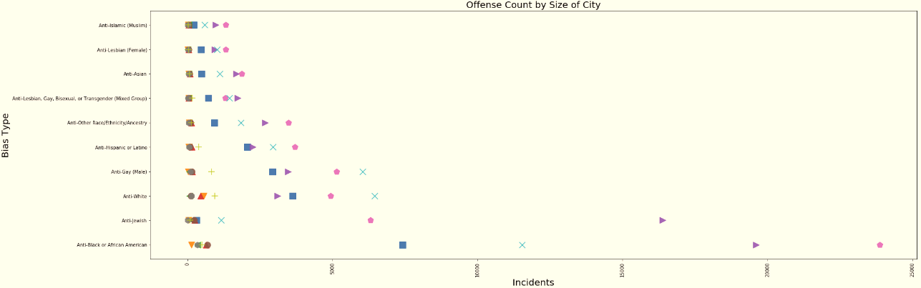
Trends of Hate Crime Offense by Bias
Notes:
On the second visualization, I compared hate crime offense by bias type. I narrowed down to the top 10 bias types and top 10 offense types and tried to see which biases were prone to which hate offenses.
After visualizing the data, I noticed that for anti-African American hate crimes, intimidation was the highest occurring incident; while for anti-Jewish hate crimes, destruction/damage/vandalism of property was the highest. The intimidation hate crime was actually significantly lower than the property damage hate crime for anti-Jewish crimes, which was usually not the case for all the other biases (intimidation being higher than property damage). I also noticed simple assault was much lower for anti-Jewish incidents relative to the other biases. For Anti-White and Anti-Gay crimes, Simple assault was the highest occurring incident.

Slide 15
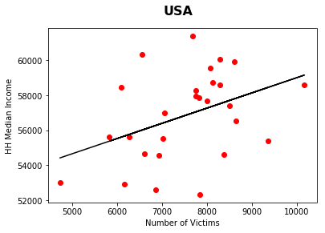
How Hate Crime Correlates with Median HH Incomes
Overall there is a slight positive correlation between rising household incomes and the rate of violent crimes.
However, this correlation is not significant enough for us to confirm our hypothesis.
How does this relationship compare at lower levels of geography?
R² Value = .16
Note: Income reported in 2017 dollars.

Slide 16
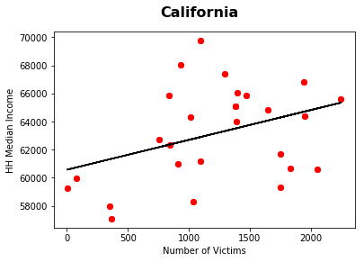
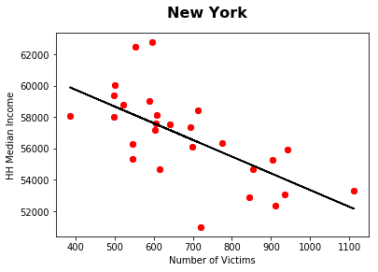
Hate Crime by State Level Comparisons
R² Value = .14
R² Value = .42

Slide 17
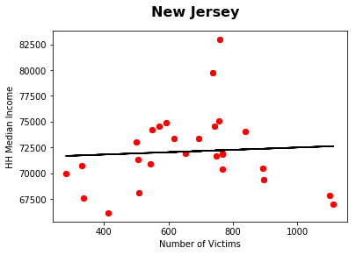
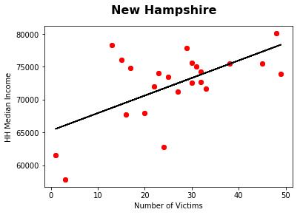
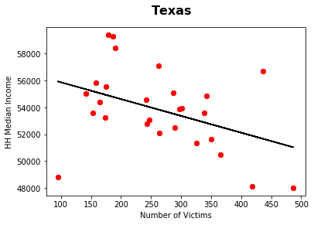
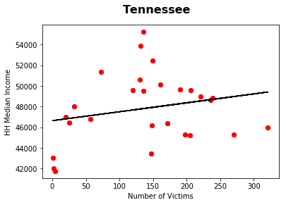
Hate Crime by State Level Comparisons
for location in location:
temp_df = final_df.loc[final_df["Location"] == location]
vics = temp_df.loc[:, "Victims"]
inc = temp_df.loc[:, "Income"]
fig, ax = plt.subplots()
fig.suptitle(location, fontsize=16, fontweight="bold")
ax.set_ylabel("HH Median Income")
ax.set_xlabel("Number of Victims")
# Set line
(slope, intercept, _, _, _) = linregress(vics, inc)
fit = slope * vics + intercept
slope, intercept, r_value, p_value, std_err = scipy.stats.linregress(vics, inc)
r_squared = r_value**2
name.append(location)
r_sqr.append(r_squared)
p_val.append(p_value)
R² Value = .01
R² Value = .37
R² Value = .17
R² Value = .05

Slide 18
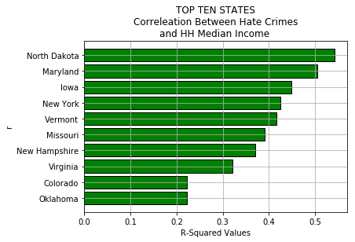
States With Highest Correlation
Among the top 10 states, Maryland and North Dakota correlated the highest with our violent crime data set.
If there is a relationship between crime data and median HH income data, it is not demonstrated in our analysis.
In other words, the data suggests that the ‘null’ argument is still valid.

Slide 19
Conclusions
Data hampered by limited reporting, but clear trends emerge with offender biases and bias variations throughout the US. For example, bias against African Americans is 2x’s greater nationally than next largest group and top bias in every State except two, NY & AR.
Certain biases that motivate hate crimes, as well as hate crime offense types, do appear to fluctuate over time. Particularly, the most prevalent types of hate crime biases and offense types experience the most fluctuation and sensitivity to significant world events.
The size of city showed different levels of hate crime offenses. In the second visualization, hate crime offense type was very different based of the group of people targeted.
Income correlates slightly with violent crime rates but results are mixed and vary by state.

Slide 20
Resources
Data Source:
FBI Crime Data Explorer :
https://crime-data-explorer.fr.cloud.gov/downloads-and-docs
Median Household Income by State: 1984 to 2017:
U.S. Census Bureau, Current Population Survey, Annual Social and Economic Supplements. For information on confidentiality protection, sampling error, non-sampling error, and definitions
https://www2.census.gov/programs-surveys/cps/techdocs/cpsmar18.pdf
Articles:
Hailey Middlebrook, “The fascinating, if unreliable, history of hate crime tracking in the US,” CNN, November 14, 2017
https://www.cnn.com/2017/01/05/health/hate-crimes-tracking-history-fbi/index.html
Hate Maps (annually tracked mapping of hate groups in US), Southern Poverty Law Center
https://www.splcenter.org/

